Slide 1


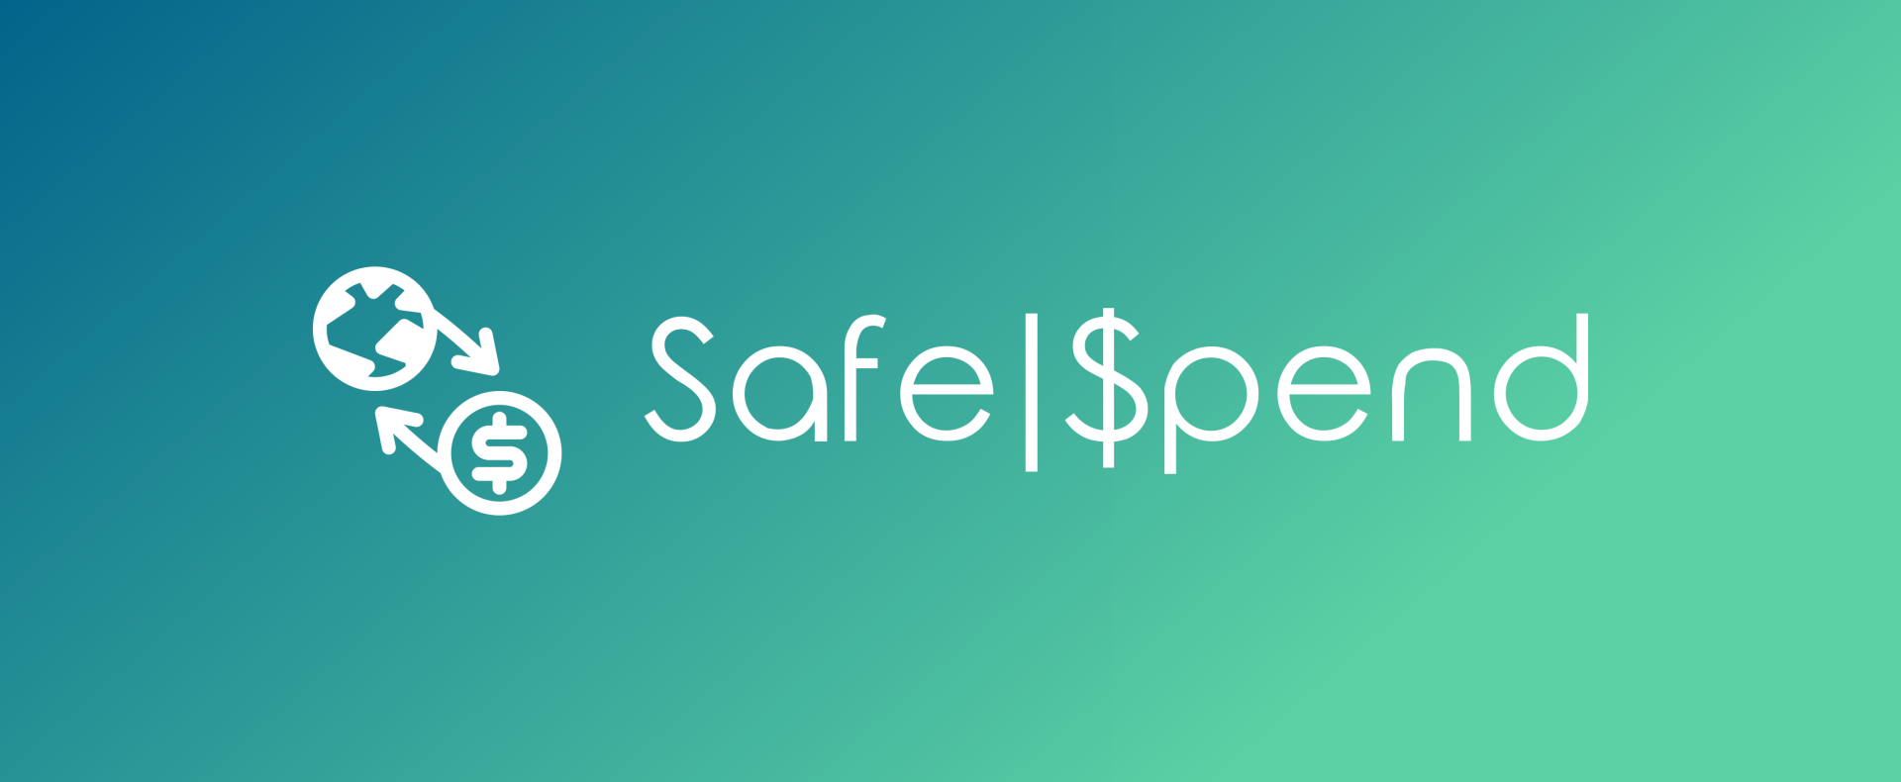


Slide 2
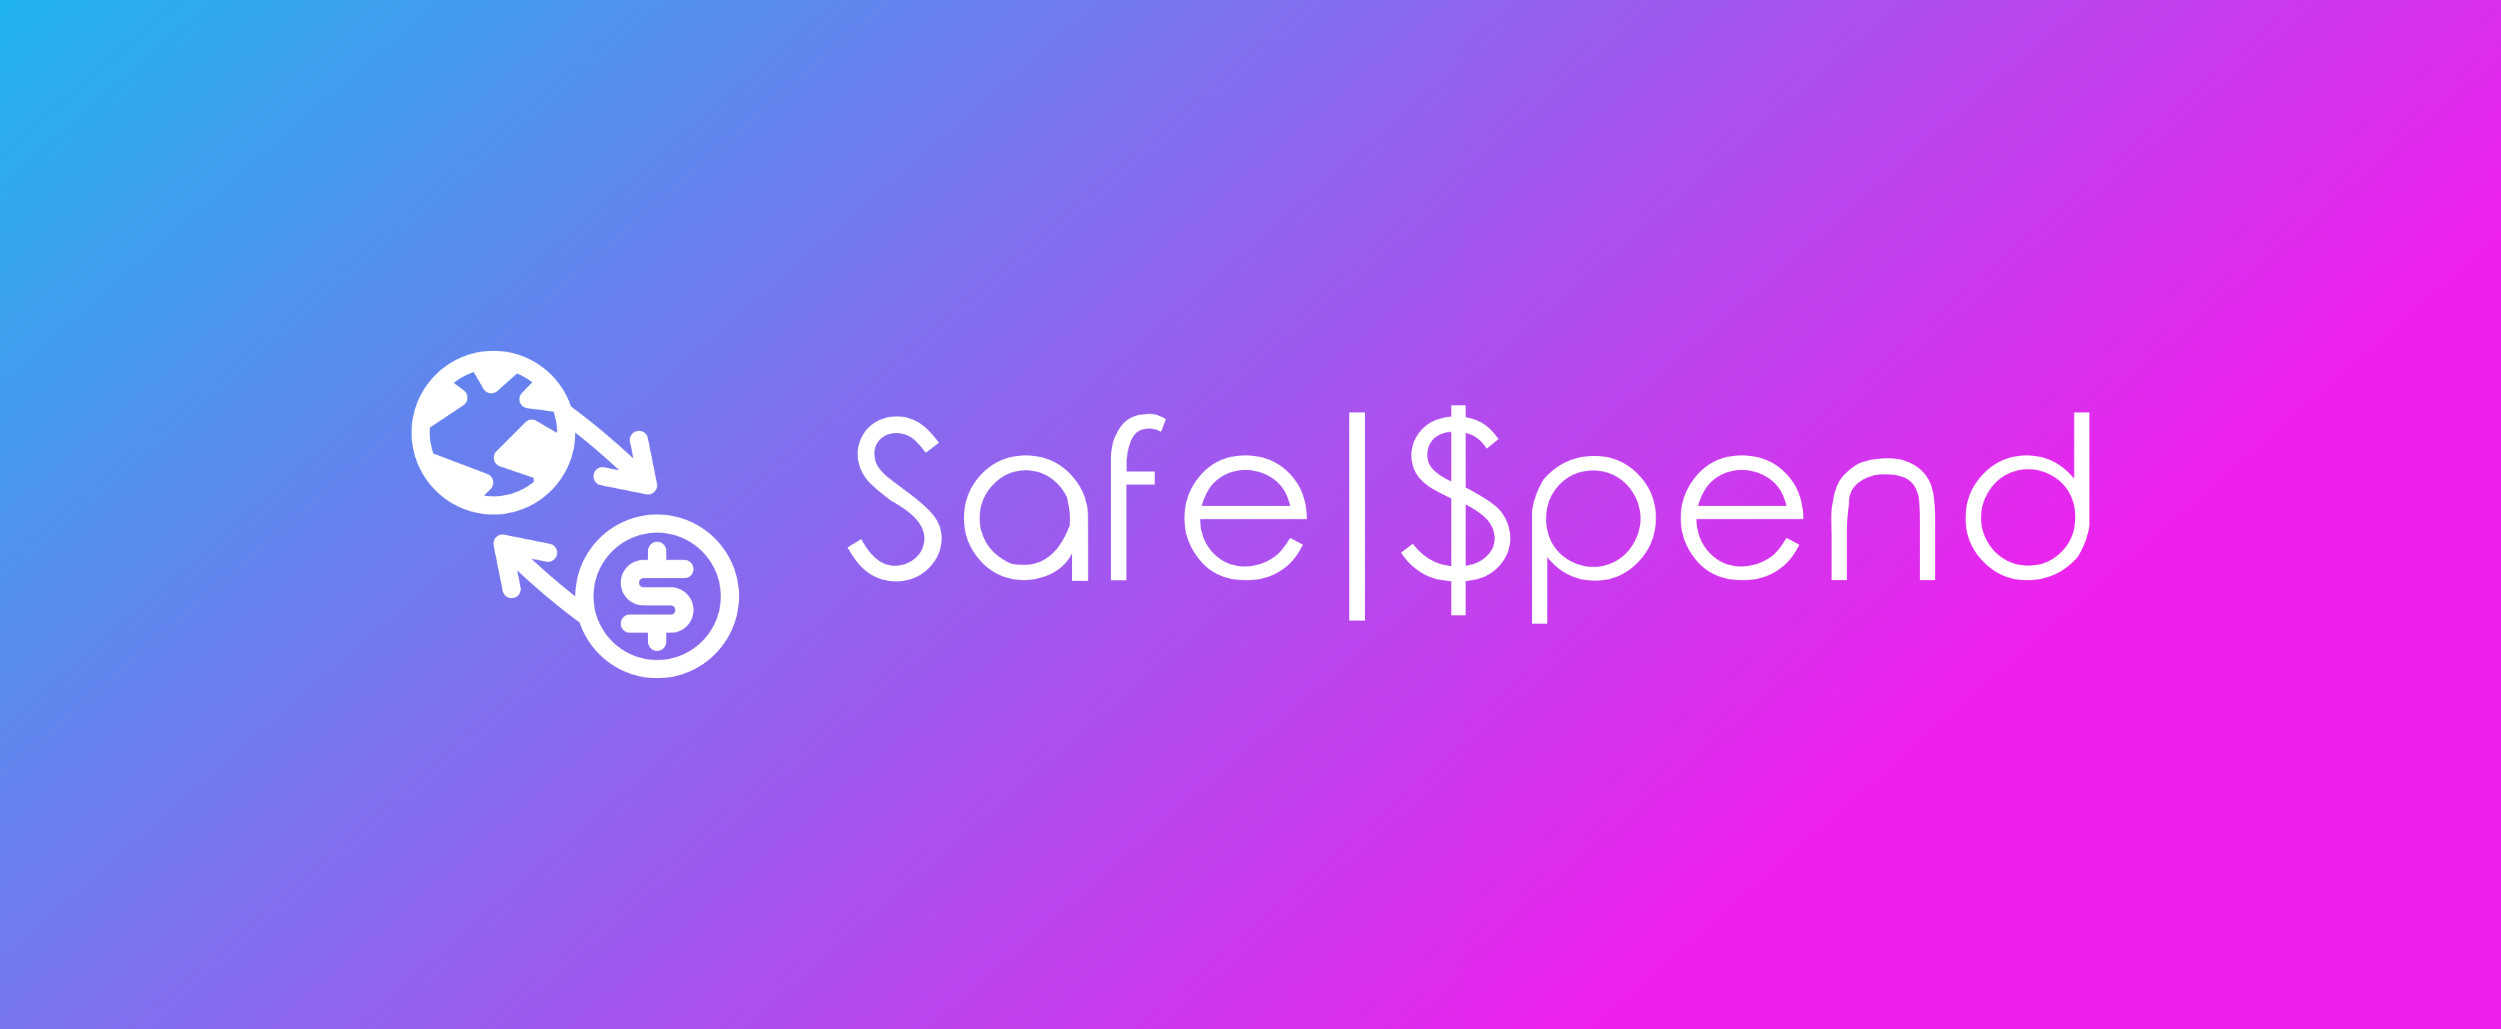




Login
User Name
Password
Remember Me
Register?
Login
Login

Slide 3
Login
User Name
Password
Remember Me
Register?
Login
Login

Slide 4



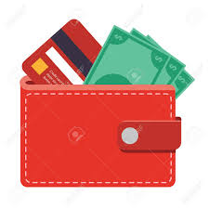
Logout
€17.30
€17.30

Slide 5
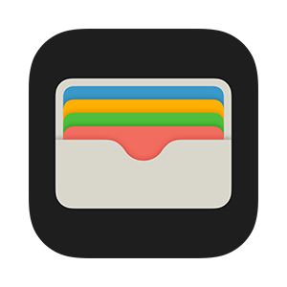
Logout
Logout
€17.30
€17.30
Camera
Wallet

Slide 6

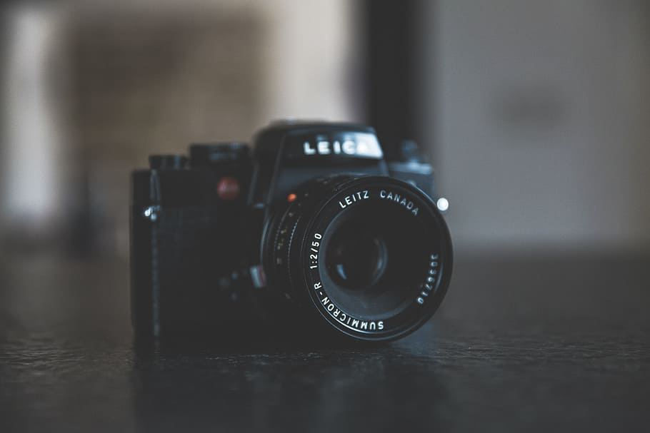

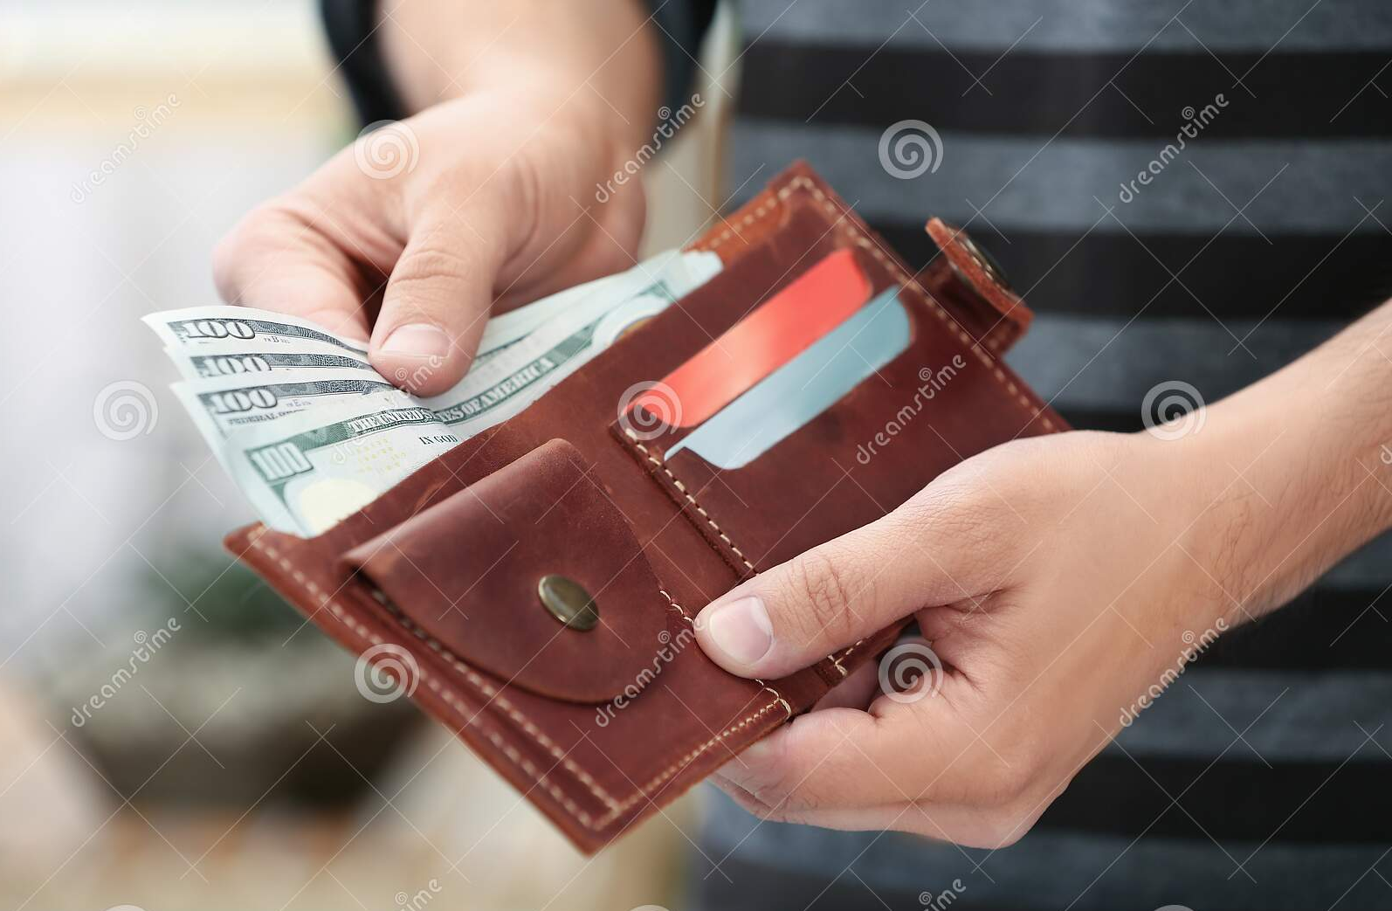
Logout
Logout
€17.30
€17.30
Camera
Camera
Wallet
Wallet

Slide 7

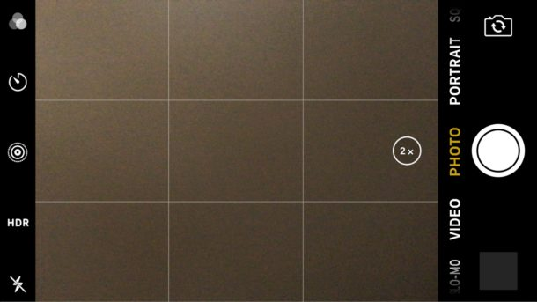
Logout
Count
Spend

Slide 8



Logout
Logout
Count
Spend
Count
Spend
You Have €20.00
You Owe €20.00
Get Change

Slide 9


Logout
Logout
Count
Spend
Count
Spend
Incorrect change
Correct change

Slide 10

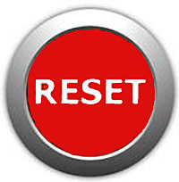
Logout
Logout
Balance: €20.00
You Have €20.00!
Balance: €20.00

Slide 11
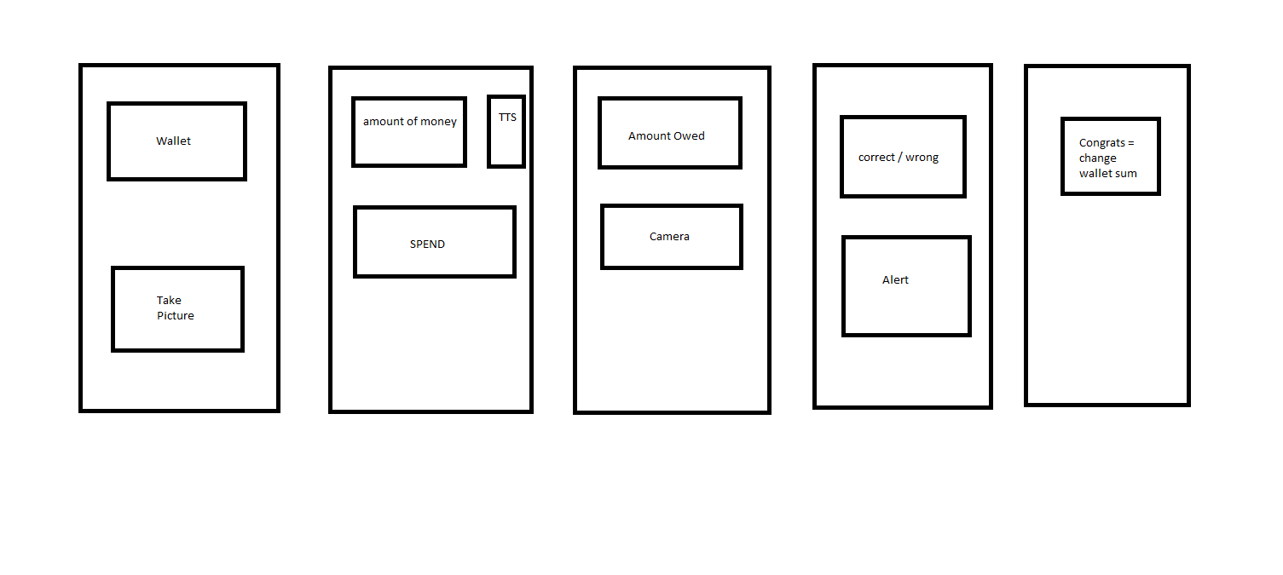

Slide 12




Slide 13
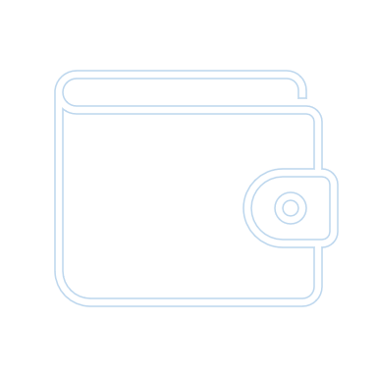



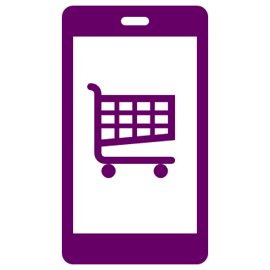


Logout
Reset
€0.00
Insert Money
Check Change
Pay

Slide 14









Logout
Logout
€50.00
X 2
- +
X 3
- +
X 2
- +
X 4
- +
- +
+
Total: 00.00

Slide 15


Logout
Logout
X 2
- +
X 2
- +
X 3
- +
X 3
- +
X 2
- +
X 2
- +
Clear Amount/Reset
- +
X 4
- +
X 4
Add Money?
Yes
No
Yes
- +
- +
No
Total: 00.00
Total: 00.00

Slide 16

Logout
Logout
€50.00
Add Money?
Yes
No
+
+
€27.80

Slide 17
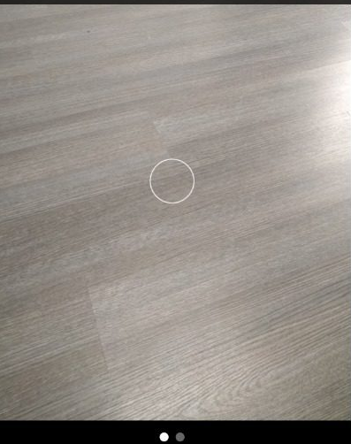
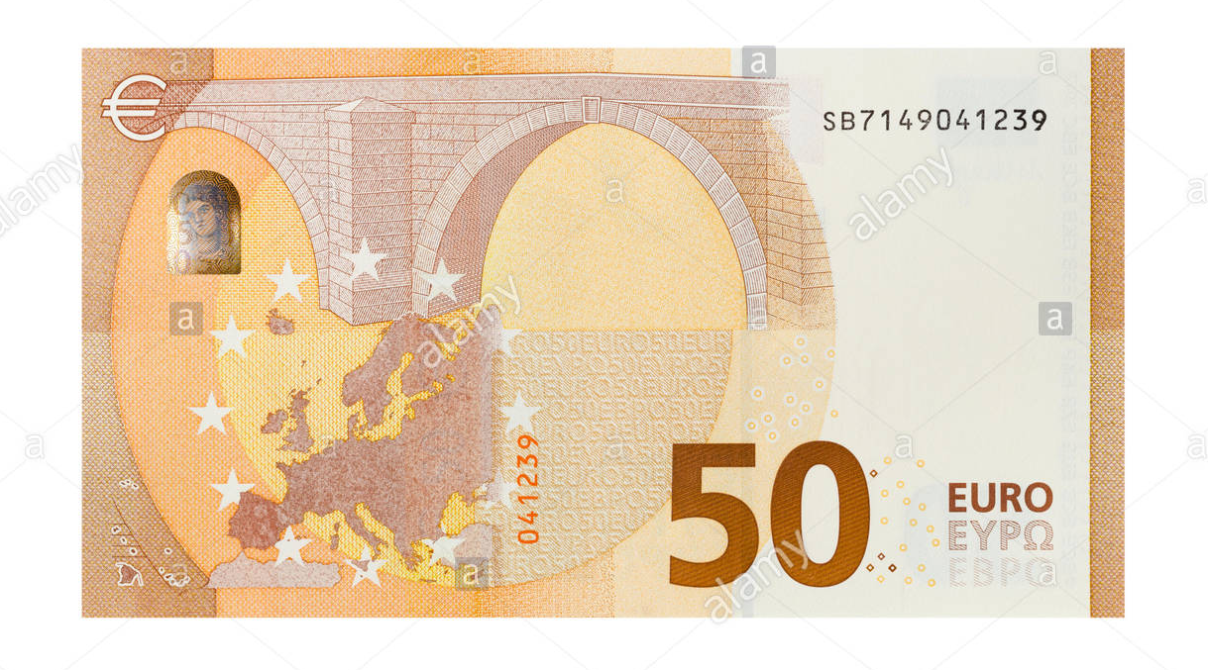
Logout
Logout
€0.00
€50.00
x1
+
Scan
Scan

Slide 18
Logout
€50.00
x1
+
Scan

Slide 19

Logout
Logout
€0.00
Reset
€50.00
Failed to Scan
Retry?
Count Money
Check Change
Pay
Scan

Slide 20
Logout
Logout
€50.00
Reset
€50.00
Count Money
Check Change
Pay
€27.80

Slide 21

Logout
Logout
€22.20
Reset
€22.20
Correct Change
Count Money
Check Change
Pay
Scan

Slide 22

Logout
Logout
€22.20
Reset
€22.20
Incorrect Change
Count Money
Check Change
Pay
Scan

Slide 23
Logout
Logout
Reset
Reset
€22.20
€00.00
Count Money
Check Change
Count Money
Check Change
Pay
Pay

Slide 24
Money App
Design document
Presentation
Development
Use Case Diagrams
Requirements
Question plan
Logo/colour plan
Feature Plan
GUI
Sequence diagram
Case diagram
GUI Prototype
Database design
Android Studio
Coding Plan
Testing Plan
Sequence

